Slide 1
DOAA’s Local Government Compliance Dashboard – Reporting Requirements, Eligibility for State Funds, and Compliance Status
Georgia Mountains Regional Commission Council
Presented by Department of Audits and Accounts on January 29, 2026
Jackie Neubert, Deputy Director
Professional Standards & Practices
Nonprofit and Local Government Section

Slide 2
Learning Objectives
Be aware of enhanced features of the Department of Audits and Accounts’ (DOAA) Local Government Compliance Dashboard
Be aware of examples of common reporting issues that may affect eligibility for state grant funds
Understand the consequences of a status of noncompliance
Be aware of the status of commission member governments

Slide 3
Section I
Georgia Mountains Regional Commission

Slide 4
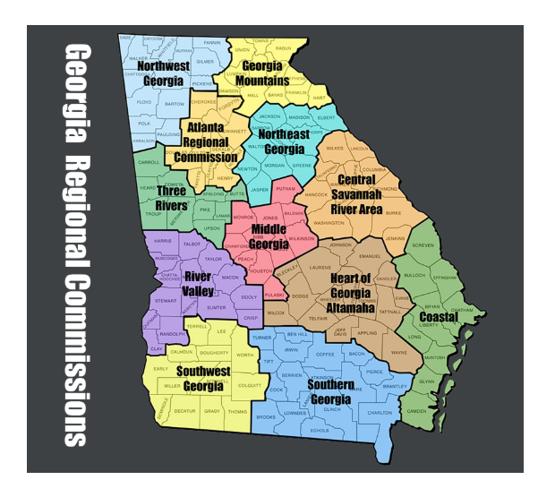
Map from Georgia Association of Regional Commissions’ Website
Georgia Mountains Regional Commission Membership:
12 Counties:
Banks, Dawson, Franklin,
Habersham, Hall, Hart,
Lumpkin, Rabun, Stephens,
Towns, Union, and White
With 37 Municipalities

Slide 5
Compliance Status of Membership
Recap of Membership:
12 counties
37 municipalities
Noncompliant members:
10 municipalities
Representing approximately 20% of total membership

Slide 6
Noncompliant Members
Members
Members
Avalon
Bowersville
Canon
Clayton
Dahlonega
Gillsville
Homer
Lula
Maysville
Oakwood

Slide 7
Section II
2025 Immigration Compliance Reporting Update

Slide 8
2025 Immigration Compliance Reporting Update
O.C.G.A. §50-36-4 requires governmental entities to submit an annual immigration compliance report.
Reporting period:
December 1, 2024, through November 30, 2025
Reporting deadline:
December 31, 2025

Slide 9
Immigration Compliance Reporting
Immigration & Reform Act Collection System opens November 1.
Annual deadline is December 31.
DOAA is not authorized to grant extensions.
Immigration & Reform Act Collection System remains open.
DOAA is now required to review submissions and report on compliance to the General Assembly.
Report will include a list of entities that did not submit.

Slide 10
Eligibility for State Funds
Three sections of the immigration reporting law have penalties specific to Cities and Counties that could prevent them from obtaining state funds and grants.
Contractor Reporting (O.C.G.A. §13-10-91) – can lose Qualified Local Government (QLG) Status
Sanctuary Policies (O.C.G.A. §36-80-23) – withholding of state funding
Public Benefits (O.C.G.A. §50-36-1) – loss of DCA grants

Slide 11
Section III
Process of Submissions to DOAA

Slide 12
Submissions Process Discussion
Electronic submissions
Extension requests
Issues that may affect compliance

Slide 13
Submission of Reports to DOAA
Required to submit electronically using the submission portal
Audited financial statements or Agreed-Upon Procedures Reports (AUP)
Local Government Audit Report Collection System
https://www.audits.ga.gov/auth

Slide 14
Submission Reminders
Submitted within 180 days after fiscal year end
Compliance status based on recorded fiscal year end
Reports cover no more than 12 months

Slide 15
Extension Requests
DOAA authorized to grant a one-time extension of up to 180 days beyond the original due date for eligible governments.
However, DOAA’s authority to grant extensions is limited to no more than two consecutive fiscal years.
Eligibility for extensions is based on a review of the number of consecutive extensions granted in the prior two fiscal years.

Slide 16
Extension Requests
Must be in writing
Must come directly from local government officials
Must include a specific reason for the delay

Slide 17
Extension Requests Recap
DOAA’s authority to grant extensions limited to no more than two consecutive fiscal years
“Local government officials” refers to authorized local government officials, such as the city or county clerk, manager/administrator, finance director, etc.
Must include a specific reason for the delay
Submission of written requests: email to locgov@audits.ga.gov or upload the requests to the submission portal

Slide 18
Issues Affecting Compliance
Audit firm does not hold a valid Georgia firm license
Draft versions of audited financial statements
Government Auditing Standards report not submitted
Modified auditor’s opinions (other than modified for qualifications)
Incorrect major fund presentation
Repeated issues with presentation or disclosures

Slide 19
GAAP Financial Statements Required
Annual financial statements required to be prepared in conformity with generally accepted accounting principles (GAAP)
If audit opinion is modified:
Opinion contains qualifications - requirement is met (overall financial statements are materially in compliance with GAAP)
Disclaimers of opinion – considered out of compliance (conformity with GAAP cannot be verified)
Adverse opinion – considered out of compliance (financial statements are not in compliance with GAAP)

Slide 20
Section IV
DOAA’s Local Government Compliance Dashboard

Slide 21
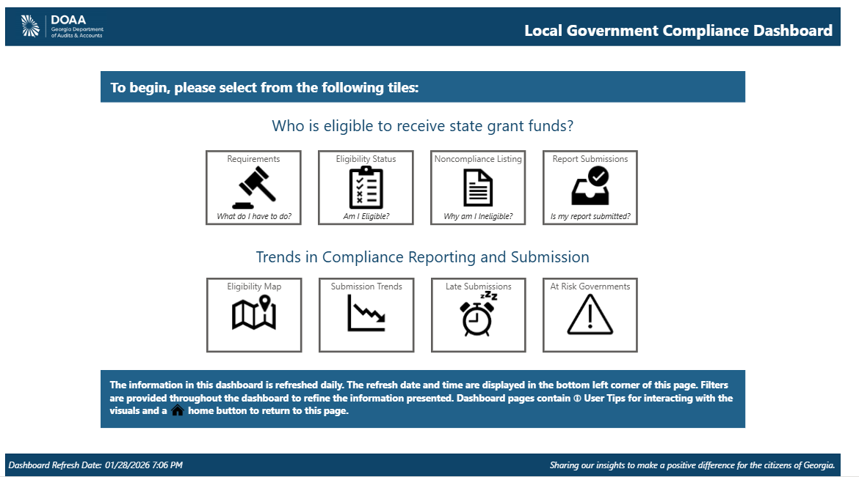
Local Government Compliance Dashboard
Key Features:
Transparency
Public Access
Efficiency

Slide 23
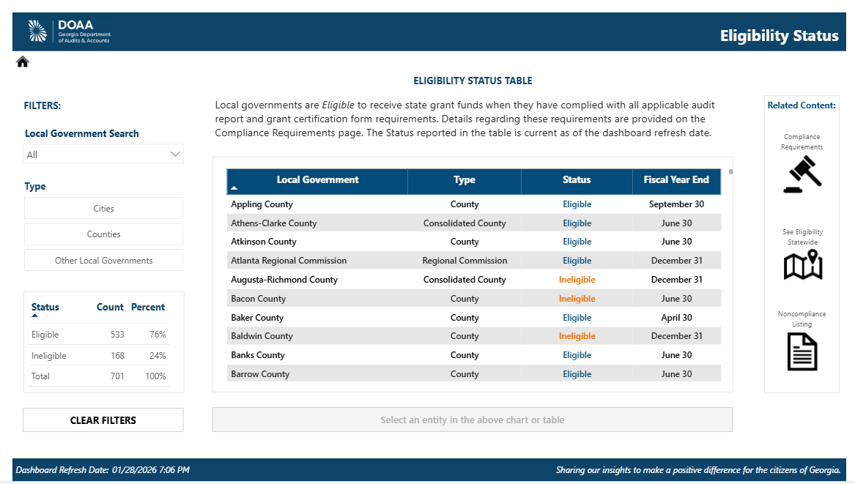

Slide 24
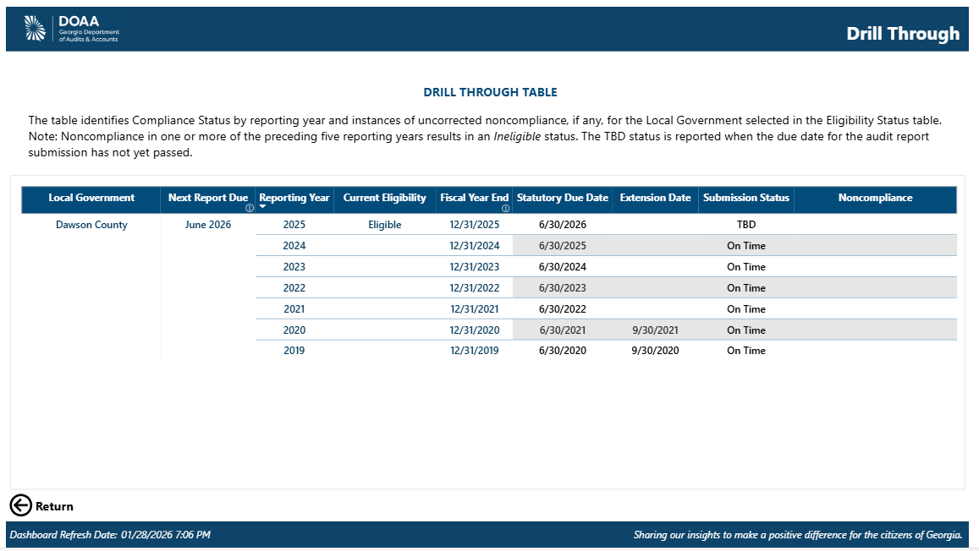

Slide 25
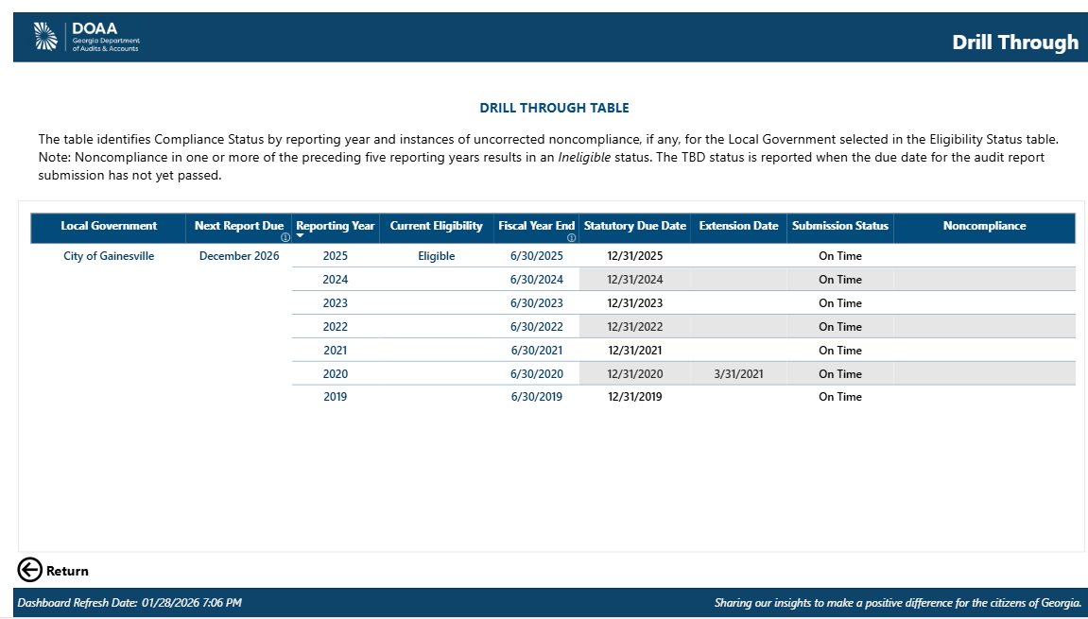

Slide 26
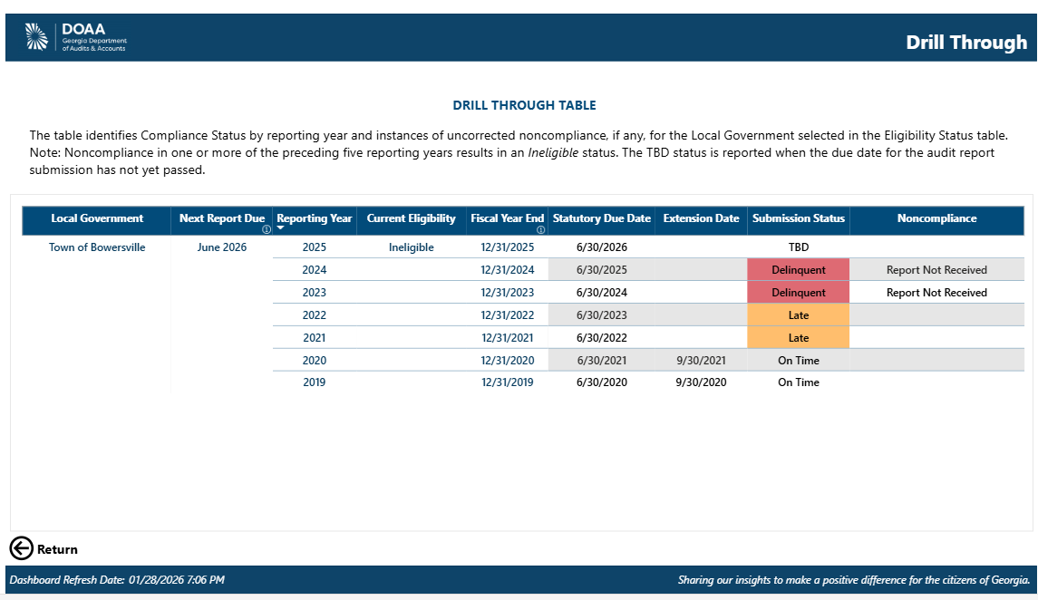

Slide 27
Noncompliance and Reporting Issues
Reporting Issues
Reasons for Noncompliance
Report Not Received
Report Not Accepted
Uncorrected Report Deficiencies
Defined Benefit Plan Reporting Deficiencies
Not submitted at statutory or extended due date
Not accepted-draft version, no valid CPA firm license, modified opinions – disclaimer or adverse, etc.
Uncorrected report deficiencies – based on desk reviews

Slide 28
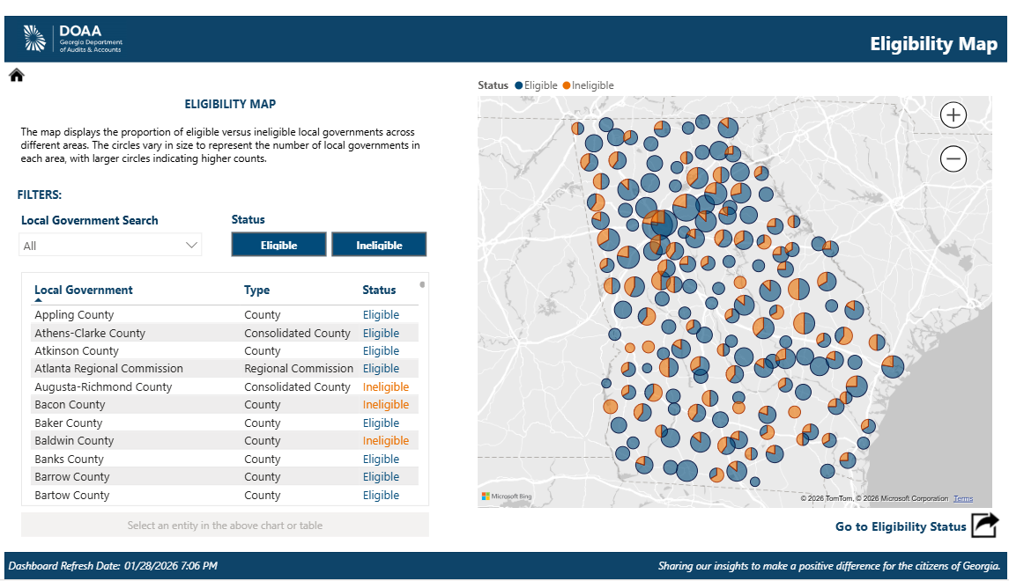

Slide 29
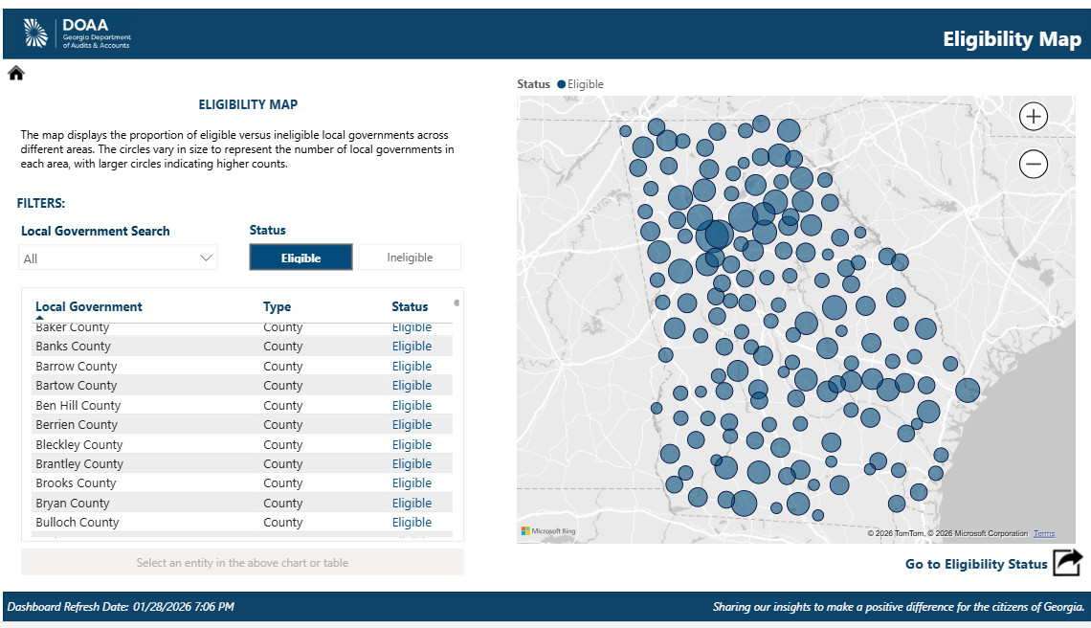

Slide 30
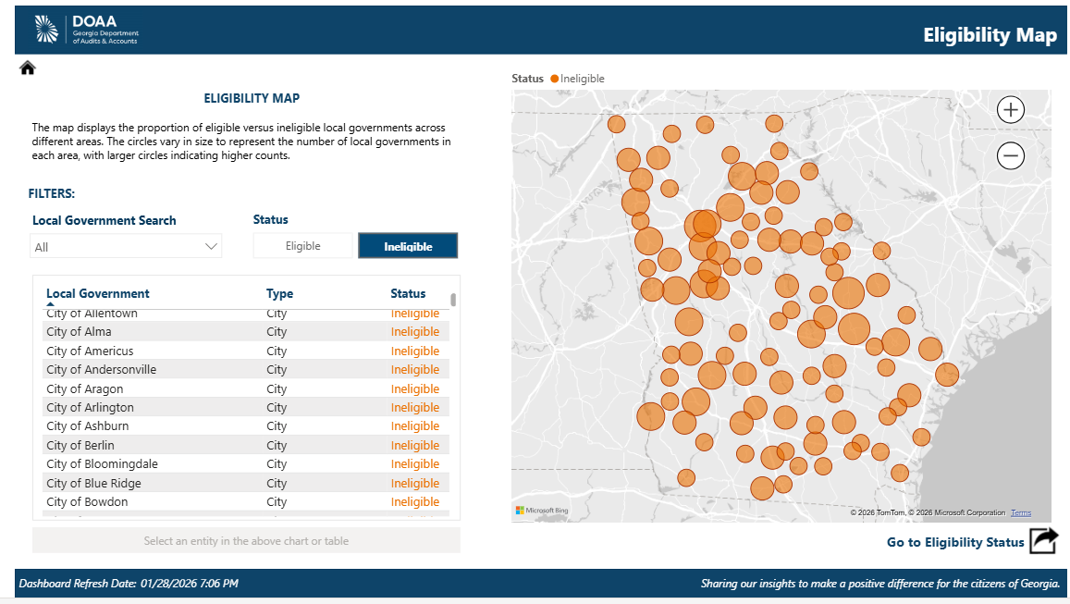

Slide 31
Contact Information
Contact us:
Jackie Neubert neubertj@audits.ga.gov
Eric Moody moodyen@audits.ga.gov
Local Government Team locgov@audits.ga.gov

